Slide 1
REFLECTION AND REFRACTION!
By:
M.Salman Hassan

Slide 2
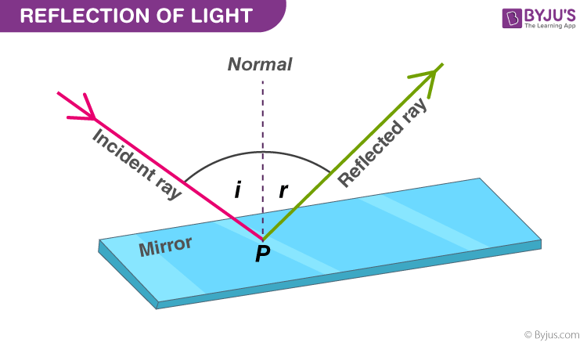
Reflection
When a ray of light approaches a smooth polished surface and the light ray bounces back, it is called the reflection of light. The incident light ray that land on the surface is reflected off the surface. The ray that bounces back is called the reflected ray. If a perpendicular were drawn on a reflecting surface, it would be called normal. The figure below shows the reflection of an incident beam on a plane mirror.

Slide 3
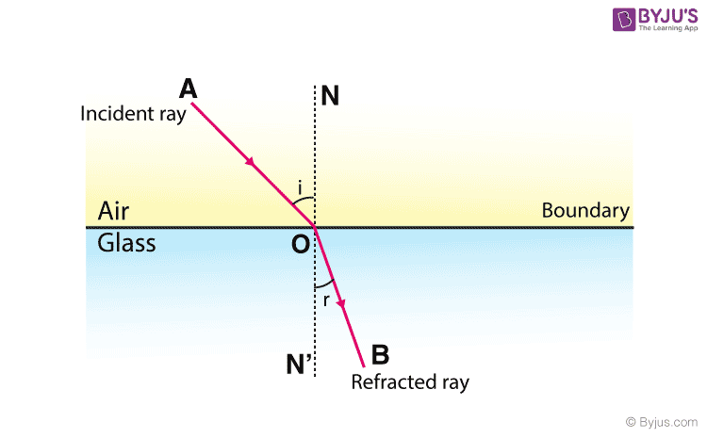
Refraction
Refraction is the bending of a wave when it passes from one medium to another. The bending is caused due to the differences in density between the two substances.

Slide 4
THANK YOU!
Hope You Understood the topic!

